Slide 1
Unit 2 – Process Management

Slide 2
Introduction
Threads
IPC
Implementing Mutual Exclusion
Classical IPC Problems
Process Scheduling (Numerical)

Slide 3
Process vs Program
Process
Program
Process is activity.
High resource requirements.
Has its own control block called PCB.
Process exists temporarily, it gets terminated on the completion of tasks.
Dynamic Entity
Program is the group of instructions.
No resource requirements only memory.
No control block
Program exists at single place and continues to exist there until deleted.
Static Entity

Slide 4
Process vs Program (contd.)
Example: Mom is cooking pasta for dinner.
Mom: CPU
Recipe: Program (method to cook [algorithm])
Pasta Ingredients: Input Data
Activities involved are processes
Reading the recipe
Collecting the ingredients
Cooking Pasta

Slide 5
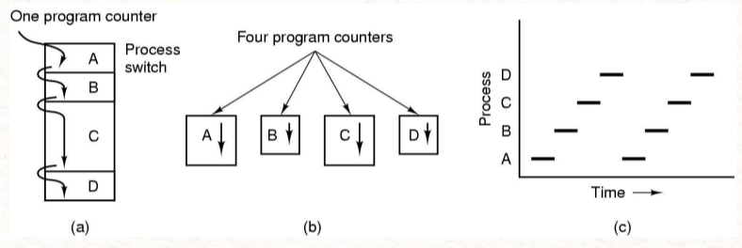
Process Models
Multiprogramming of four programs in memory (a)
Conceptual model of four independent, sequential process, each with its own flow of control and each one running independently (b)
Only one process running at a time (c)

Slide 6
Process Models (contd.)
Uni Programming
Multi Programming
Multi Processing

Slide 7
Uni Programming
Only one process at a time.
Pons: Easier for OS designer
Cons: Poor Performance
D
C
B
A
Time

Slide 8
Multi Programming
Multiple processes at a time
Pons: Better system performance
Cons: Complexity in OS
OS requirements for multiprogramming:
Policy: to determine which process is to schedule.
Mechanism: to switch between the processes.
B
A
Time

Slide 9
Multi Processing
System with multiple processors
Multiprocessing system can have
Multiprocessor
Multi-core processor
D
C
B
A
Time

Slide 10

Process States
New
Ready
Running
Waiting
Terminated

Slide 11
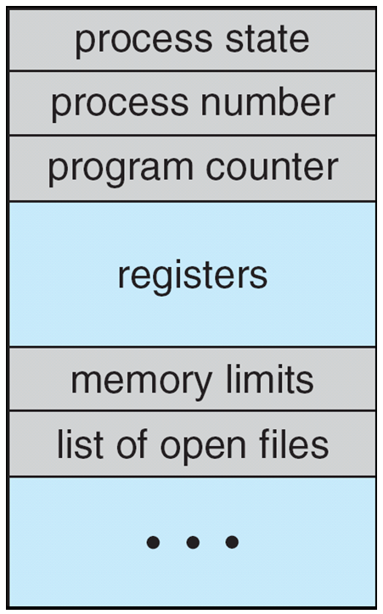
Process Control Block / Process Table
Information associated with each process (also called task control block)
Process state – running, waiting, etc
Program counter – location of instruction to next execute
CPU registers – contents of all process-centric registers
CPU scheduling information- priorities, scheduling queue pointers
Memory-management information – memory allocated to the process
Accounting information – CPU used, clock time elapsed since start, time limits
I/O status information – I/O devices allocated to process, list of open files

Slide 12

PCB (contd.)

Slide 13
Threads
Threads are like Process.
Allows more than one job to be performed at a time.
Thread – Lightweight Process whereas Process - Heavyweight Process.
Many applications now-a-days are multithreaded
Web Browser
A Thread for retrieving data from network
Another Thread for displaying text and images
Word Processor
A Thread for displaying graphics
Another thread for reading keystrokes from user
Third Thread for performing grammar checks in background

Slide 14
Thread vs Process
Thread
Process
Thread is light weight, takes less resources than process
Thread switching doesn’t need interaction with OS
All threads can share same file, memory and child processes
Multiple threaded processes use fewer resources
One thread can R-W or change another thread data
Process is heavy weight or resource intensive
Process switching needs interaction with OS
In multi processing, each process executes same code but has its own file processes and memory
Multiple processes without threads use more resources
Processes are independent of one another

Slide 15
Types of Thread
User-Level Thread
Kernel-Level Thread

Slide 16
User-Level Thread
Management done by user-level threads library
Implemented as a library
Library provides support for thread creation, scheduling and management with no support from the kernel.
Three primary thread libraries:
POSIX Pthreads
Windows threads
Java threads
Pons:
Thread switching doesn’t require kernel mode privileges
Can run on any OS
Fast to create and manage
Cons:
Multithreaded applications can’t take advantage of multiprocessing

Slide 17
Kernel Level Threads
Supported by kernel
Kernel performs thread creation, scheduling and management in kernel space.
Slower to create and manage
Blocking system calls are no problem
Pons:
Can schedule multiple threads from same process on multiple processes
If one thread is blocked then kernel schedules another thread on the same process
Cons:
Slower to create and manage than user thread
Specific to OS

Slide 18
Multithreading Model
One-to-One Model
Many-to-One Model
Many-to-Many Model

Slide 19
One-to-One Model
Each user-level thread maps to kernel thread
Creating a user-level thread creates a kernel thread
More concurrency than many-to-one
Number of threads per process sometimes restricted due to overhead
Examples
Windows
Linux
Solaris 9 and later

Slide 20
Many-to-One Model
Many user-level threads mapped to single kernel thread
One thread blocking causes all to block
Multiple threads may not run in parallel on multicores system because only one may be in kernel at a time
Few systems currently use this model
Examples:
Solaris Green Threads
GNU Portable Threads

Slide 21
Many-to-Many Model
Allows many user level threads to be mapped to many kernel threads
Allows the operating system to create a sufficient number of kernel threads
Solaris prior to version 9
Windows with the Thread Fiber package

Slide 22
Inter-Process Communication
A mechanism which allows process to communicate with each other and synchronize their actions.
Processes within a system may be independent or cooperating
Cooperating process can affect or be affected by other processes, including sharing data
Reasons for cooperating processes:
Information sharing
Computation speedup
Modularity
Convenience
Two models of IPC
Shared memory
Message passing

Slide 23
IPC (contd.) a. Message Passing b. Shared Memory

Slide 24
Independent-Cooperating Process
Independent process cannot affect or be affected by the execution of another process
Cooperating process can affect or be affected by the execution of another process
Advantages of process cooperation
Information sharing
Computation speed-up
Modularity
Convenience

Slide 25
IPC-Shared Memory
An area of memory shared among the processes that wish to communicate
The communication is under the control of the users processes not the operating system.
Major issues is to provide mechanism that will allow the user processes to synchronize their actions when they access shared memory.

Slide 26
IPC-Message Passing
Mechanism for processes to communicate and to synchronize their actions
Message system – processes communicate with each other without resorting to shared variables
IPC facility provides two operations:
send(message)
receive(message)
The message size is either fixed or variable

Slide 27
IPC-Message Passing
If processes P and Q wish to communicate, they need to:
Establish a communication link between them
Exchange messages via send/receive
Implementation of communication link
Physical:
Shared memory
Hardware bus
Network
Logical:
Direct or indirect
Synchronous or asynchronous
Automatic or explicit buffering

Slide 28
Direct Communication
Processes must name each other explicitly:
send (P, message) – send a message to process P
receive(Q, message) – receive a message from process Q
Properties of communication link
Links are established automatically
A link is associated with exactly one pair of communicating processes
Between each pair there exists exactly one link
The link may be unidirectional, but is usually bi-directional

Slide 29
Indirect Communication
Messages are directed and received from mailboxes (also referred to as ports)
Each mailbox has a unique id
Processes can communicate only if they share a mailbox
Properties of communication link
Link established only if processes share a common mailbox
A link may be associated with many processes
Each pair of processes may share several communication links
Link may be unidirectional or bi-directional
Mailbox sharing
P₁, P₂, and P₃ share mailbox A
P₁, sends; P₂ and P₃ receive

Slide 30
Critical Section
Process have to access shared memory or files or doing other critical tasks
That part of the program where the shared memory is accessed is called critical section or critical region
Consider system of n processes {p₀, p₁, … p_{n-1}}
Each process has critical section segment of code
Process may be changing common variables, updating table, writing file, etc
When one process in critical section, no other may be in its critical section
Critical section problem is to design protocol to solve this
Each process must ask permission to enter critical section in entry section, may follow critical section with exit section, then remainder section

Slide 31
CS-Conditions to have good solution
No two processes may be in critical section
No assumptions may be made about the speed or number of CPU
No process running outside the critical section may block other process
No process should have wait forever to enter its critical section

Slide 32
Critical Section Solutions
Mutual Exclusion - If process P_{i} is executing in its critical section, then no other processes can be executing in their critical sections
Progress - If no process is executing in its critical section and there exist some processes that wish to enter their critical section, then the selection of the processes that will enter the critical section next cannot be postponed indefinitely
Bounded Waiting - A bound must exist on the number of times that other processes are allowed to enter their critical sections after a process has made a request to enter its critical section and before that request is granted
Assume that each process executes at a nonzero speed
No assumption concerning relative speed of the n processes

Slide 33
Race Conditions
It occurs inside a critical section
This happens when the result of multiple thread execution in critical section differs according to the order in which the threads execute

Slide 34
Race Condition (contd.)
counter++ could be implemented as register1 = counter register1 = register1 + 1 counter = register1
counter-- could be implemented as register2 = counter register2 = register2 - 1 counter = register2
Consider this execution interleaving with “count = 5” initially:
S0: producer execute register1 = counter {register1 = 5} S1: producer execute register1 = register1 + 1 {register1 = 6} S2: consumer execute register2 = counter {register2 = 5} S3: consumer execute register2 = register2 – 1 {register2 = 4} S4: producer execute counter = register1 {counter = 6 } S5: consumer execute counter = register2 {counter = 4}

Slide 35
Implementing Mutual Exclusion
Prohibiting more than one process from reading writing the same data at the same time
How to Manage Race Condition
Mutual Exclusion with Busy Waiting
Lock Variable
Interrupt Disabling
Strict Alteration
Peterson’s Algorithm
Test and Set Lock
Mutual Exclusion without Busy Waiting
Sleep and wakeup
Semaphore

Slide 36
ME with Busy Waiting
Continuously testing a variable until some value appears is called busy waiting
If the entry is allowed it execute else it sits in tight loop and waits
Busy-waiting: consumption of CPU cycles while a thread is waiting for a lock
Very inefficient
Can be avoided with a waiting queue
Interrupt Disabling
Each process disable all interrupts just after entering its CR and reenable them just before leaving it
No clock interrupt, no other interrupt, no CPU switching to other process until the process turn on the interrupt

Slide 37
ME with Busy Waiting
Lock Variable
A single, shared (lock) variable, initially 0. When a process wants to enter its CR, it first test the lock. If the lock is 0, the process set it to 1 and enters the CR. If the lock is already 1, the process just waits until it becomes 0.
Strict Alteration
Processes share a common integer variable turn.
If turn == i then process Pi is allowed to execute in its CR,
if turn == j then process Pj is allowed to execute

Slide 38
ME with Busy Waiting
Peterson’s Algorithm
Before entering its CR, each process call enter_region with its own process number, 0 or 1 as parameter.
Call will cause to wait, if need be, until it is safe to enter
When leaving CR, the process calls leave_region to indicate that it is done and to allow other process to enter CR

Slide 39
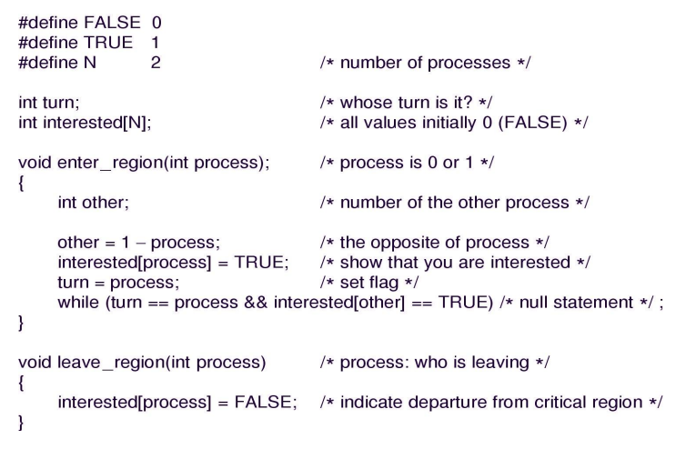
Peterson’s Algorithm

Slide 40
ME with Busy Waiting
Test and Set Lock
Help from the hardware
Reads the content of the memory word lock into register RX and the stores a non-zero value at the memory address lock
A shared variable (lock) is used to coordinate access to shared memory
When lock is 0, any process may set it to 1 using TSL instructions and then read or write the shared memory
When all the tasks are done, lock is set back to 0 using ordinary move instructions.

Slide 41
ME without Busy Waiting
Sleep and Wakeup
Both Peterson’s solution and TSL are correct but have defect requiring busy waiting
These approaches waste CPU time
Sleep and wakeup is simplest IPC primitives which blocks instead wasting CPU time
When a process is not permitted to access its critical section, it uses a system call known as Sleep, which causes that process to block
The process will not be scheduled to run again, until another process uses the Wakeup system call
In most cases, Wakeup is called by a process when it leaves its critical section if any other processes have blocked

Slide 42
ME without Busy Waiting (contd.)
Sleep and Wakeup (Producer-Consumer Problem)
Two process share a common, fixed sized buffer
Suppose one process, producer, is generating information that the second process, consumer, is using
Their speed may be mismatched, if producer insert item rapidly, the buffer will full and go to the sleep until consumer consumes some item, while consumer consumes rapidly, the buffer will empty and go to sleep until producer put something in the buffer
Code at OS Sleep and Wake

Slide 43
ME without Busy Waiting (contd.)
Semaphores
E. W. Dijkstra (1965) suggested using an integer variable to count the number of wakeups, called a semaphore
It could have the value 0, indicating no wakeups ware saved, or some positive value if one or more wakeups were pending
Operations: Down and Up
Down: checks if the value greater than 0, if true, decrements the value and continue
If value is 0, the process is put to sleep without completing down
Checking value, changing it, and possibly going to sleep, is all done as single action
Up: increments the value
If one or more processes were sleeping, unable to complete earlier down operation, one of them is chosen and is allowed to complete its down.

Slide 44
Monitors
Set of multiple routines which are protected by a ME lock
None of the routine in the monitor can be executed by a thread until that thread acquires lock
This means only one thread can be executed within a monitor at a time
Any other thread must wait for the thread that’s currently executing to give up control of the lock
Processes that wish to access the shared data, do through the execution of monitor functions

Slide 45
Message Passing
This method of IPC uses two primitives :
Send
Receive
These are system calls rather than constructors
They can easily put into library procedures such as
Send(destination, &message)
Receive(source, &message)

Slide 46
Classical IPC Problem
Producer-Consumer Problem
Sleeping Barber Problem
Dinning Philosopher Problem

Slide 47
Process Scheduling
The part of OS that makes the choice which process to run next whenever two or more process are in ready state – Schedular
The algorithm it uses is called Scheduling algorithm
Process scheduling is the activity of process manager that handles the removal of the running process from the CPU and the selection of another process on the basis of particular strategy

Slide 48
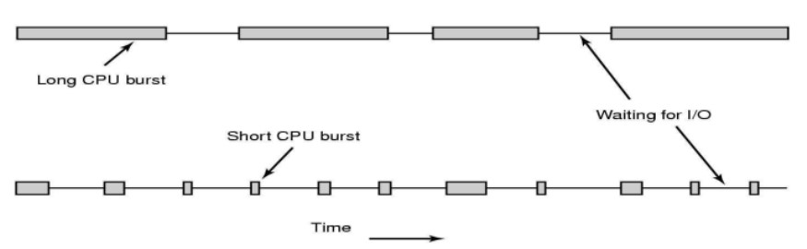
Process Behavior
The process that uses CPU until quantum(time) expires – CPU Bound
The process that uses CPU briefly then generate I/O – I/O Bound
CPU bound process have long CPU-burst while I/O bound process have short CPU burst

Slide 49
Preemptive v/s Non-Preemptive
Non-preemptive:
Once a process has been given the CPU, it runs until blocks for I/O or termination
Treatment of all processes is fair
Response times are more predictable
Useful in real-time system
Shorts jobs are made to wait by longer jobs - no priority
Preemptive:
Processes are allowed to run for a maximum of some fixed time
Useful in systems in which high-priority processes requires rapid attention
In timesharing systems, preemptive scheduling is important in guaranteeing acceptable response times
High overhead

Slide 50
Scheduling Criteria
CPU utilization – keep the CPU as busy as possible
Turnaround time – amount of time to execute a particular process T.A.T = Completion time – Arrival Time or BT+WT
Waiting time – amount of time a process has been waiting in the ready queue W.T = T.A.T - Brust time
Response time – amount of time it takes from when a request was submitted until the first response is produced, not output (for time-sharing environment)

Slide 51
FCFS Scheduling
Process Burst Time
P₁ 24
P₂ 3
P₃ 3
Suppose that the processes arrive in the order: P₁ , P₂ , P₃ The Gantt Chart for the schedule is:
Waiting time for P₁ = 0; P₂ = 24; P₃ = 27
Average waiting time: (0 + 24 + 27)/3 = 17

Slide 52
FCFS Scheduling (contd.)
Suppose that the processes arrive in the order:
P₂ , P₃ , P₁
The Gantt chart for the schedule is:
Waiting time for P₁ = 6; P₂ = 0; P₃ = 3
Average waiting time: (6 + 0 + 3)/3 = 3
Much better than previous case
Convoy effect - short process behind long process
Consider one CPU-bound and many I/O-bound processes

Slide 53
SJF Scheduling
Process Burst Time
P₁ 6
P₂ 8
P₃ 7
P₄ 3
SJF scheduling chart
Average waiting time = (3 + 16 + 9 + 0) / 4 = 7

Slide 54
SRTF Scheduling
Now we add the concepts of varying arrival times and preemption to the analysis
Process Arrival Time Burst Time
P₁ 0 8
P₂ 1 4
P₃ 2 9
P₄ 3 5
Gantt Chart
Average waiting time = [(10-1)+(1-1)+(17-2)+5-3)]/4 = 26/4 = 6.5

Slide 55
Round Robin (RR) Scheduling
Each process is assigned a time interval (quantum), after the specified quantum, the running process is preempted to the last and a new process is allowed to run
Advantages:
Fair allocation of CPU across the process.
Used in timesharing system.
Low average waiting time when process lengths very widely

Slide 56
RR with quantum=4
Process Burst Time
P₁ 24
P₂ 3
P₃ 3
The Gantt chart is:

Slide 57
Priority ( Event-Driven [ED] )Scheduling
A priority number (integer) is associated with each process
The CPU is allocated to the process with the highest priority (smallest integer = highest priority)
Problem: Starvation – low priority processes may never execute
Solution: Aging – as time progresses increase the priority of the process

Slide 58
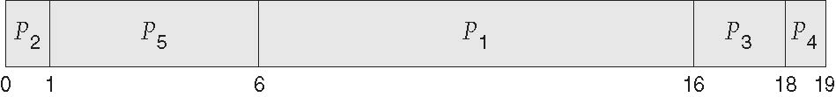
Priority Scheduling (contd.)
Process Burst Time Priority
P₁ 10 3
P₂ 1 1
P₃ 2 4
P₄ 1 5
P₅ 5 2
Priority scheduling Gantt Chart

Slide 59
Multilevel-Feedback-Queues (MFQ)
A process can move between the various queues; aging can be implemented this way
MFQ implements multilevel queues having different priority to each level (here lower level higher priority), and allows a process to move between the queues.
If the process use too much CPU time, it will be moved to a lower-priority queue
Higher the level of queue(lower the priority) : larger the quantum size
This leaves the I/O-bound and interactive processes in the high priority queue

Slide 60
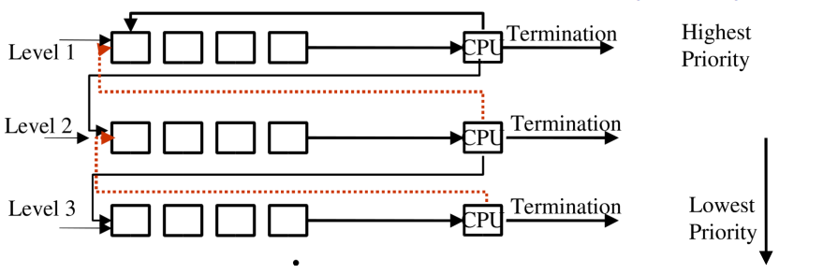
MFQ (contd.)

Slide 61
Real-Time CPU Scheduling
Soft real-time systems – no guarantee as to when critical real-time process will be scheduled
Hard real-time systems – task must be serviced by its deadline
Two types of latencies affect performance
Interrupt latency – time from arrival of interrupt to start of routine that services interrupt
Dispatch latency – time for schedule to take current process off CPU and switch to another

